Slide 1

TOTAL TECHNOLOGY
REPORTLAB COMPLETE TUTORIAL

Slide 2

REPORTLAB Intra-Paragraph Markup
TUTORIAL 18
TOTAL TECHNOLOGY

Slide 3

What are the available markups
INTRODUCTION TO PARAGRAPH
TOTAL TECHNOLOGY

Slide 4
<b> or <strong> - bold <i> - italicize <u> - underline <a href> - Adding a link <a name> - Adding an anchor <strike> - Strike-through <br/> - line break
TOTAL TECHNOLOGY

Slide 5
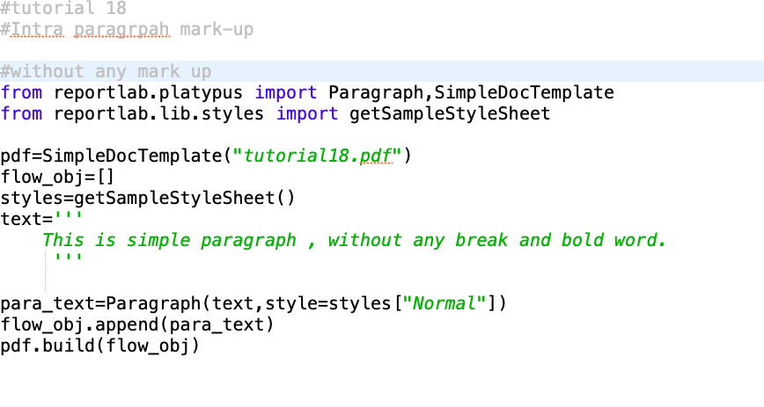
Sample use cases without the mark-ups
TOTAL TECHNOLOGY

Slide 6
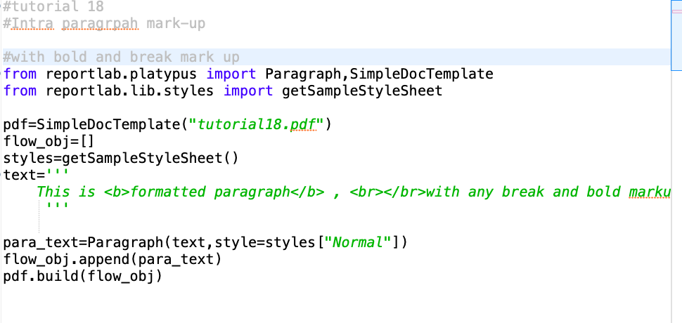
Sample use cases with the br & b marktups
TOTAL TECHNOLOGY

